Slide 1
ICT Multi-Media Lesson 1:
Using Presentation Software

Slide 2
Objectives
6.1.1: Describe presentation software and the ways it can be used.
6.1.2: Create and/or modify a "slide master" or template to apply a consistent appearance to a presentation.
6.1.3: Add and format titles, subtitles and talking points in presentation slides.
6.1.5: Insert and format images/graphics in presentation slides.
6.1.6: Insert new or duplicate slides in a presentation.
6.1.7: Modify slide transitions in a presentation to include animation.
6.1.8: Insert and/or modify sound settings and timing in a presentation.
6.1.9: Modify the sequence of slides in a presentation.
6.1.10: Produce a presentation that includes text, graphics and images, and present it.
6.1.11: Modify a presentation's setup to repeat (i.e., loop) the presentation continuously.
6.3.1: Create a progressive slide presentation using graphical design/layout template features (e.g., SmartArt) and animated transitions.
6.3.4: Create a multimedia presentation that incorporates edited video, animation, music and/or narration, and that applies principles of good design, smooth transitions and effective message delivery

Slide 3
Common Features Presentation Software
Multimedia – text, graphics, sound and multimedia files can be included in the presentation.
Templates – a large number of professional looking templates are typically provided with the software. Additional templates can be downloaded from the internet for little or no cost.
Slide designs/layouts – there are a large number of slide designs/layouts which can be used to create a well-designed slide very quickly.
Animations – a set of effects, which can be applied to animate objects to add visual interest.

Slide 4
Common Features Presentation Software
Transitions – a set of effects, which can be applied from one slide to the next to add visual interest.
Speed and timing – the speed and the timing of the transitions control how fast one slide advances to the next, and when the transition begins.
Loops – the presentation can be set to loop so that it will play continuously.
Handouts – a copy of the slides can be printed out and given to the audience to write notes on or to keep as a reminder of the presentation.
Timing – used to auto play a presentation

Slide 5
Advantages Presentation Software
the software is intuitive and require minimal skills to begin using.
the software can create colorful, attractive designs using the standard templates and themes.
the software makes it easy to insert sounds and multimedia to clarify or emphasize a point.
the presenter is not necessarily tethered to a desk or lectern to deliver the presentation.

Slide 6
Disadvantages of Presentation Software
Tempting to use too much text, which makes the information difficult to read from a distance.
Audio and visual effects can be distracting.
Presentations can look amateurish as people get carried away with features such as Word Art, background colors, animations, timings, etc.
Need to have a computer and projection equipment in place to display the slides to the audience.

Slide 7
Popular Presentation Software
Software | Platform | Cost | Delivery Method
Google Slides http://www.google.com/slides/about/ | Browsers: Chrome, IE, Safari App: Android, iPad, iPhone | Free | Web-based; requires Google Drive
Microsoft PowerPoint http://office.microsoft.com/en-us/powerpoint/ | PC, Mac Use Office Mobile 365 for mobile and cloud | Purchase | Download Use Office 365 for mobile and cloud
OpenOffice Impress http://www.openoffice.org/product/impress.html | PC, Mac, Linux | Free | Download
Libre Office Impress http://www.libreoffice.org/discover/impress/ | PC, Mac, Linux | Free | Download
Prezi http://prezi.com/index/0/ | iPad | Free | App download/ Web-based

Slide 8
Presentation Mediums
Video projectors most popular.
Can be connected to a laptop, desktop, or mobile device
Used to display your presentation onto a screen, a board, or a wall.

Slide 9
Presentation Mediums
For small audiences a computer or tablet can be used.
Simply use the monitor or screen of your computer or tablet to show your presentation.

Slide 10
Presentation Mediums
Converted to video and an audio track can be added.
Interactive whiteboards
Uploaded to the internet
Kiosks in public spaces such as malls, hotel lobbies, conference centers, etc.

Slide 11
Creating Effective Presentations
Minimize the number of words on each slide.

Slide 12
Creating Effective Presentations
Stick to the rule of 6 x 6

Slide 13
Creating Effective Presentations
Limit the number of slides.
Avoid putting words in all capital letters

Slide 14
Creating Effective Presentations
Leave plenty of white space

Slide 15
Creating Effective Presentations
Use a slide master feature to create a template.

Slide 16
Creating Effective Presentations
Avoid textured or patterned backgrounds.

Slide 17
Creating Effective Presentations
Limit the number and color of fonts.

Slide 18
Creating Effective Presentations
Avoid the use of flashy transitions or animations.
Avoid using special effects.

Slide 19
Best Practices Creating & Delivering
Use good quality.
The minimum file size for any graphic is 72 dots per inch (dpi).
Do not read directly from your slides.
Practice with someone who has never seen your presentation.
Make sure to face your audience when presenting.
Always have a backup of your slide presentation.

Slide 20
Best Practices Creating & delivering
Use good quality images that are high enough resolution when projected on a larger screen.
The minimum file size for any graphic is 72 dots per inch (dpi)
Do not read directly from your slides.
The slides are for the audience, not for the presenter.
Refer to your slides, but read from your notes and/or your memory.
Practice with someone who has never seen your presentation.
Ask them for honest feedback about the content, colors, images, and any effects that you have included.

Slide 21
Best Practices Creating & delivering
Make sure to face your audience when presenting.
Many presenters face the direction of their presentation rather than their audience, which is the wrong direction to face and feels rude.
Always have a backup of your slide presentation.
If you have a copy of your presentation on the laptop you are presenting from, make sure to have a backup copy on a USB "thumb" drive or stored in the "cloud."

Slide 22
Example: Bad Presentation

Slide 23
Example: Bad Presentation

Slide 24
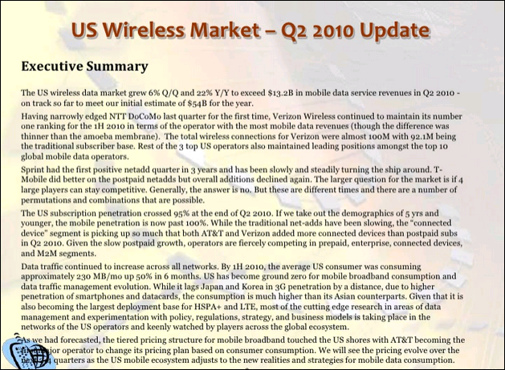
Example: Bad Presentation

Slide 25
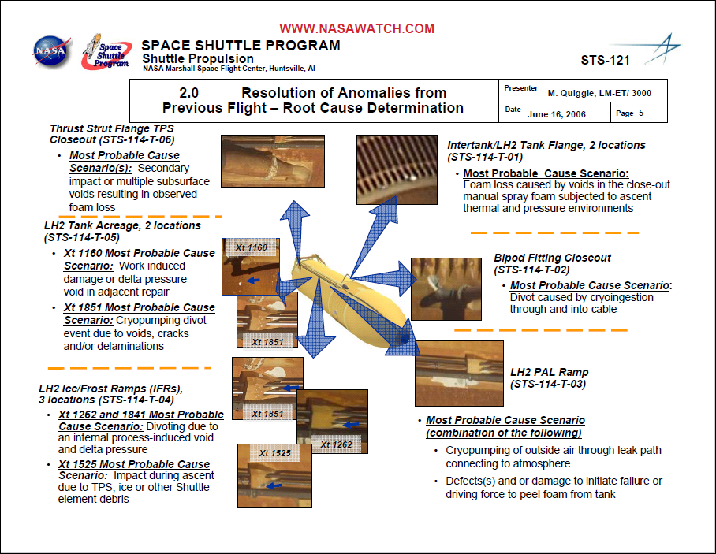
Example: Bad Presentation

Slide 26
Example: Bad Presentation

Slide 27
Storing Your Documents - Cloud Computing
Cloud computing – Cloud computing refers to services and applications offered over the Internet.

Slide 28
Storing Your Documents – Google Drive
Google Drive – A personal cloud storage service from Google that lets users store and synchronize digital content across computers, laptops and mobile devices, including Android-powered tablet and smartphone devices.
Google Docs – Free Web-based applications from Google in which documents, spreadsheets, slides and forms can be created, edited and stored online. Files can be accessed from any computer with an Internet connection and a full-featured Web browser.
Installing Google Drive – You can keep your Google Drive files on your desktop by downloading Google Drive on your Mac or PC.

Slide 29
Storing Your Documents -
OneDrive – A personal cloud storage service from Microsoft that lets users store and synchronize up to 15 GB for free of digital content across computers, laptops and mobile devices, including Android-powered tablet and smartphone devices.
Installing OneDrive – You can keep your OneDrive files on your device by downloading the OneDrive on your desktop, tablet, phone, Xbox.

Slide 30
Presentation Software Overview
Create, edit, and present presentations.
Collaborate and share presentations with others online.
It is a common practice to collaborate with others when creating a presentation.
Import and convert existing presentations, such as converting a Microsoft PowerPoint presentation to Google Slides.
Insert multimedia, such as images and videos, into your presentation.

Slide 31
Mechanics: Designs / Theme
Used to provide a consistent look for all slides in a presentation.
Affect the backgrounds, font styles, font colors and object styles for all slides within a presentation.
You can change the look and feel of your presentation by choosing one of the pre-existing themes.
Powerpoint = Designs
Google Slides = Themes
PowerPoint Designs

Slide 32
Mechanics – Slide Background
The area of the slide behind the placeholders, headings, text and other content.
You can change the color of the slide background or insert an image as a background.
Background changes can be applied to a single slide, a group of selected slides or to all of the slides in the presentation.
PowerPoint
Google Slides

Slide 33
Mechanics: Slide Layouts
Provide a starting point for the slides in a presentation.
Used to define the structure, positioning and formatting for all of the content that appears on a slide.
Contain placeholders that position and hold content such as text, tables, videos and images.
When you add content to a placeholder, it is automatically formatted using the associated theme settings.
You can use the slide layouts associated with the theme you have chosen, or change the slide layouts to suit your needs.
You can add, delete, move and modify layouts as needed.

Slide 34
Mechanics: Slide Layouts
In a new presentation, the first slide is automatically created using the Title Slide layout.
By default, when you create a new slide using the New Slide command, the slide will have a Title and Body layout.

Slide 35
Mechanics: Placeholders
Considered an object
Can be manipulated and formatted in the same manner as other objects, such as text boxes, images, tables, lines, shapes, word art, and so on.
When you format a placeholder it affects the entire placeholder, not just the text within it.

Slide 36
Mechanics: Slide Master
Used to apply global settings, such as font style and logo placement, to the slides used in a presentation.
Save an enormous amount of time.
A change in the slide master affects all slides that follow.
Each presentation theme includes one slide master and a set of related slide layout masters.
Slides that are available are determined by the theme settings you have selected.
You can edit the master slide as well as each individual slide layout.

Slide 37
Mechanics: Slide Master
A layout can have as many body text placeholders as desired, but can have only one title and one subtitle placeholder.
The master slide contains the default placeholder styles and arrangement, slide background, text styles, list options, and shapes for all slides contained in a presentation, regardless of which slide layout is used.
The individual slide layout masters determine the default placeholder styles and arrangement, slide background, text styles, list options and shapes for that particular slide layout.

Slide 38
Mechanics: Slide Master - PowerPoint

Slide 39
Mechanics: Slide Master – Google Slides

Slide 40
Mechanics: Proofing
Spellcheck
Have others review your presentation and provide feedback.
Read your text backwards to catch errors you might have missed.
Read your text out loud.
Be careful with homonyms, such as "they're," "their" and "there," or "to," "too" and "two."
Double-check punctuation.
Check the flow and logic of the information.

Slide 41
Working with Text & Objects
Slides have a pre-determined number of placeholders, based on the selected slide layout.
You can insert a text box instead of a placeholder to add more text areas or to add text in a different location without opening the master editor window.
A text box is a drawing object that contains text.
Text boxes can be resized and moved in the same manner as other objects, such as placeholders.
Presentation software includes a variety of lines and shapes that can be used on their own or that can be combined to create graphic art

Slide 42
Working with Text & Objects
Format Painter: allows you to select a format you wish to use in multiple places and quickly make changes.
Order of Objects:
Bring Forward — Move the selected object one layer up, closer to the viewer.
Bring to Front — Move the selected object to the top layer, closest to the viewer.
Send Backward — Move the selected object one layer back, away from the viewer.
Send to Back — Move the selected object to the bottom layer, farthest from the viewer.

Slide 43
Working with Text & Objects
Aligning Objects
Align Horizontally Left — Align all objects with the object farthest to the left on the slide.
Align Horizontally Center — Center all objects based on the center point of each object.
Align Horizontally Right — Align all objects with the object farthest to the right on the slide.
Align Vertically Top — Align all objects with the object at the highest point on the slide.

Slide 44
Working with Text & Objects
Aligning Objects
Align Vertically Middle — Align all objects at the middle of the slide.
Align Vertically Bottom — Align all objects with the object at the lowest point on the slide.
Center on Page Horizontally — Arrange the objects from left to right on the slide with equal space between each.
Center on Page Vertically — Arrange the objects from top to bottom on the slide with equal space between each.

Slide 45
Grouping Objects

Slide 46
Inserting Images
Upload — Choose an image saved on your computer.
Screenshot — Insert an image using screenshots on your computer.
URL — Paste or type the URL (Web address) of an image from the Web.
Google Drive or OneDrive — Search your Google Drive or OneDrive to choose an image.
Photo Album — Search your photo album to choose an image.
Search — Search Google, Life or the stock photography archive for images. It is important to note that many images found online are copyrighted and cannot be reused without first obtaining permission.
Paste — You can also copy an image and paste it directly into your presentation.

Slide 47
Transitions & Animations
Transitions
Animations
Animated effects that control how each slide replaces the previous one.
Add to text and objects.
Objects can be revealed or appear and disappear on the slide
Default: when you click the mouse button
Objects can have more than 1 animation

Slide 48
Presentations Basics
Speaker Notes: add speaker notes to each slide to help remember talking points
Open when in presentation mode
Show time spent in presentation
Timing: use “timing” of animations and transitions to keep on schedule

Slide 49
Publishing - Sharing
Email as an attachment – small audience, will use personally
Publish to the Web – large, unknown audience
Print copies for audience – small audience and need to take notes

